Slide 1
LINEAR SYSTEMS
MATH 15 - Linear Algebra

Slide 2
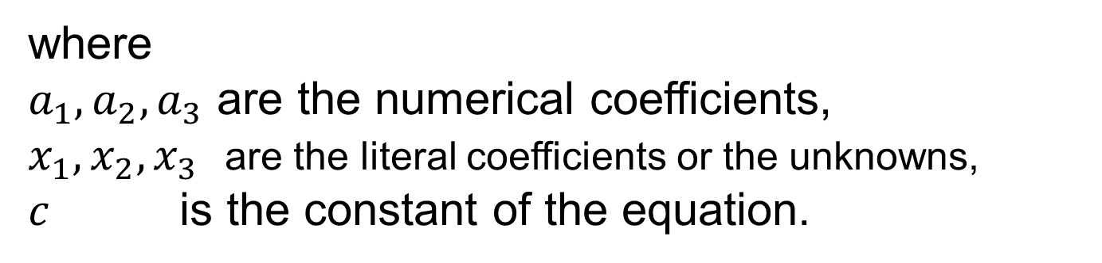
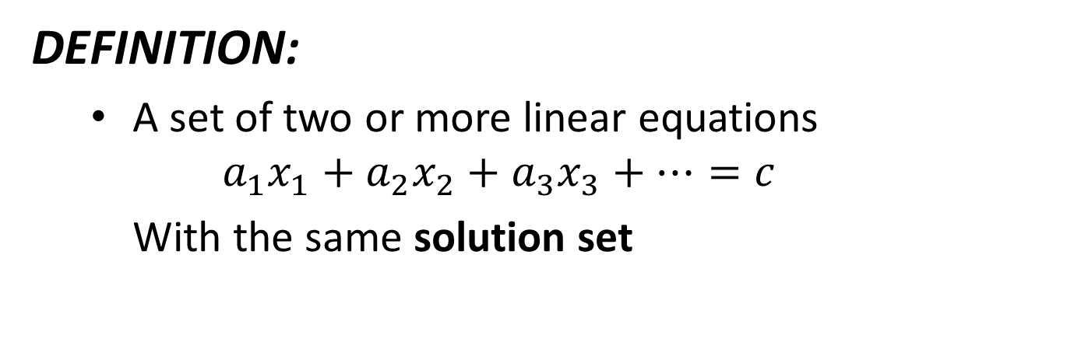
LINEAR SYSTEM
DEFINITION:
A set of two or more linear equations
$$a_{1}x_{1}+a_{2}x_{2}+a_{3}x_{3}+⋯=c$$
With the same solution set
where
$a_{1}, a_{2}, a_{3}$ are the numerical coefficients,
$x_{1}, x_{2}, x_{3}$ are the literal coefficients or the unknowns,
$c$ is the constant of the equation.

Slide 3
TYPES OF LINEAR SYSTEM
DEPENDING ON THE NUMBER OF SOLUTION
LINEAR SYSTEM CAN BE CATEGORIZED AS:
CONSISTENT
INCONSISTENT
DEPENDENT
Has a unique or single solution set
Has no solution
Has infinitely many solutions

Slide 4
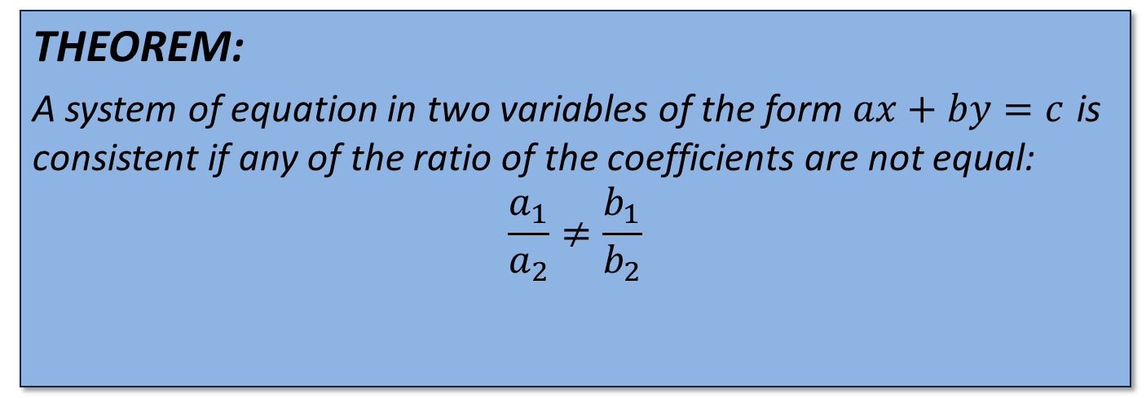
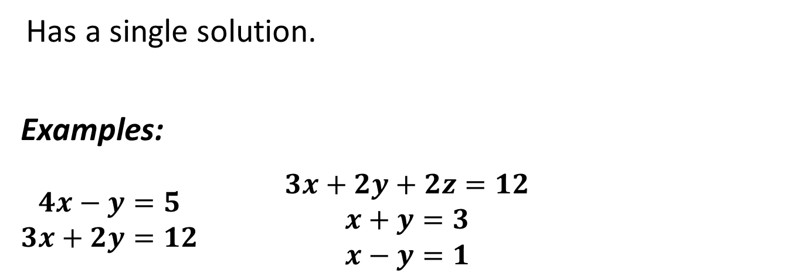
CONSISTENT SYSTEM
Has a single solution.
Examples:
$\begin{matrix}4x−y=5 \\ 3x+2y=12\end{matrix}$ $\begin{matrix}3x+2y+2z=12 \\ x+y=3 \\ x−y=1\end{matrix}$
THEOREM:
A system of equation in two variables of the form $ax+by=c$ is consistent if any of the ratio of the coefficients are not equal:
$$\frac{a_{1}}{a_{2}}≠\frac{b_{1}}{b_{2}}$$

Slide 5
CONSISTENT SYSTEM
GRAPHICAL INTERPRETATION:

Slide 6
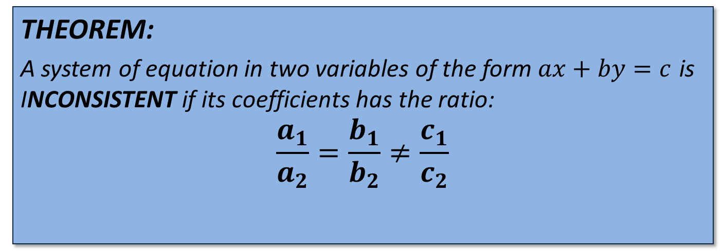
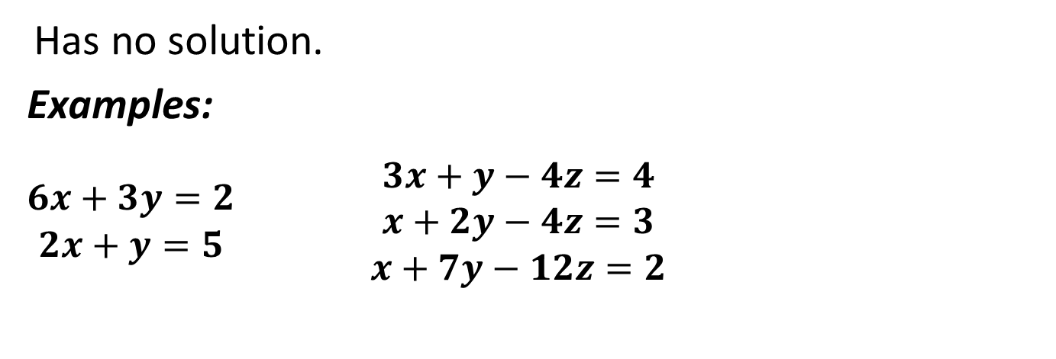
INCONSISTENT SYSTEM
Has no solution.
Examples:
$\begin{matrix}6x+3y=2 \\ 2x+y=5\end{matrix}$ $\begin{matrix}3x+y−4z=4 \\ x+2y−4z=3 \\ x+7y−12z=2\end{matrix}$
THEOREM:
A system of equation in two variables of the form $ax+by=c$ is INCONSISTENT if its coefficients has the ratio:
$$\frac{a_{1}}{a_{2}}=\frac{b_{1}}{b_{2}}≠\frac{c_{1}}{c_{2}}$$

Slide 7
INCONSISTENT SYSTEM
GRAPHICAL INTERPRETATION:

Slide 8
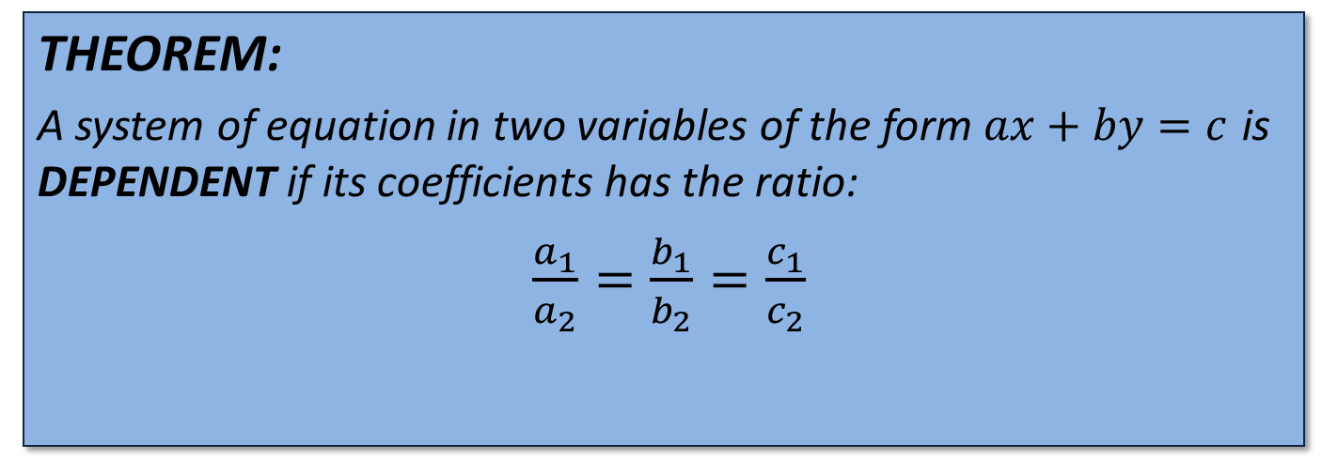
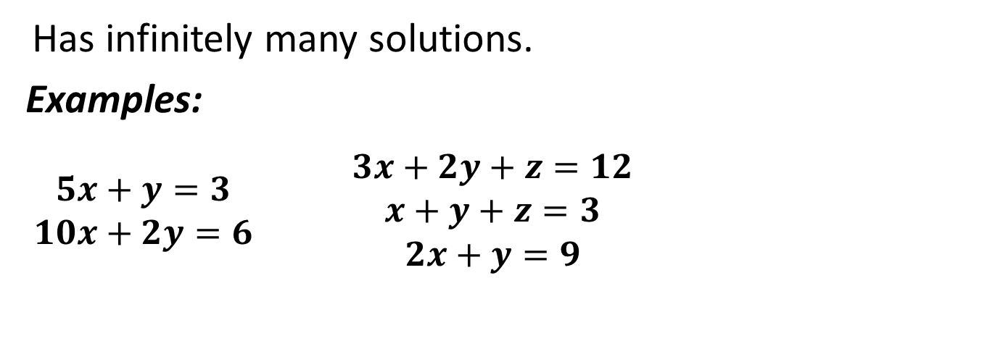
DEPENDENT SYSTEM
Has infinitely many solutions.
Examples:
$\begin{matrix}5x+y=3 \\ 10x+2y=6\end{matrix}$ $\begin{matrix}3x+2y+z=12 \\ x+y+z=3 \\ 2x+y=9\end{matrix}$
THEOREM:
A system of equation in two variables of the form $ax+by=c$ is DEPENDENT if its coefficients has the ratio:
$\frac{a_{1}}{a_{2}}=\frac{b_{1}}{b_{2}}=\frac{c_{1}}{c_{2}}$

Slide 9
DEPENDENT SYSTEM
GRAPHICAL INTERPRETATION:

Slide 10
METHODS OF FINDING A SOLUTION
Graphical Method
The graphical method of solving a system of linear equations is a method that determines the solution in terms of the common point(s) or the point(s) of intersection among the graphs representing each of the equations in the system.
Steps:
Draw the graphs associated to the equations of the system.
Determine the common point or the point of intersection among the graphs.

Slide 11
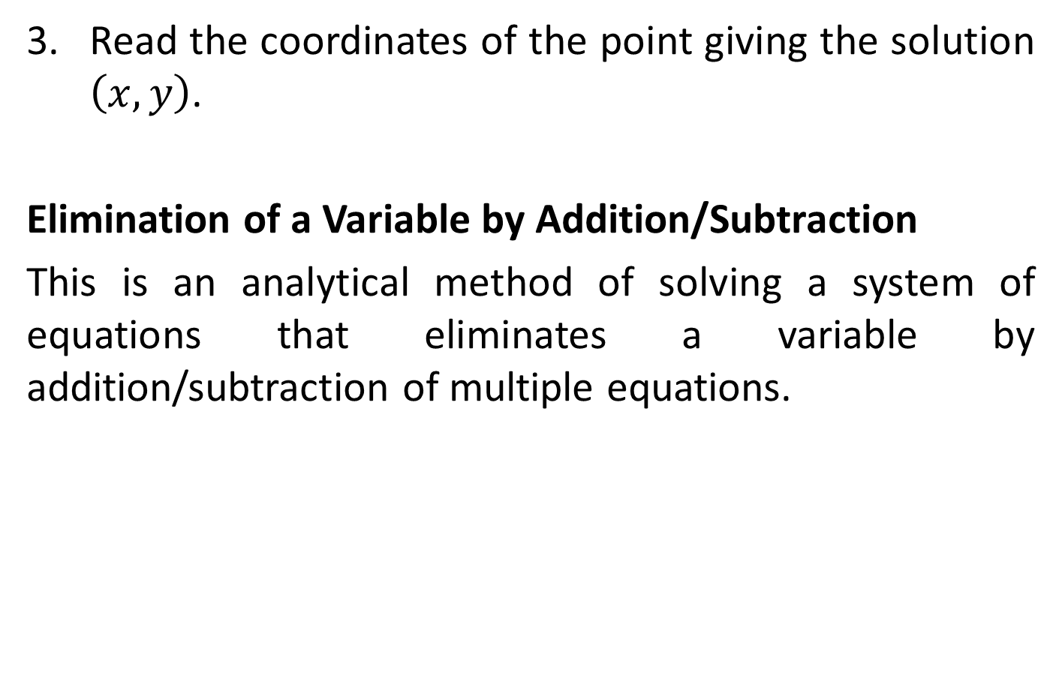
METHODS OF FINDING A SOLUTION
Read the coordinates of the point giving the solution $\left(x, y\right)$.
Elimination of a Variable by Addition/Subtraction
This is an analytical method of solving a system of equations that eliminates a variable by addition/subtraction of multiple equations.

Slide 12
METHODS OF FINDING A SOLUTION
Elimination of a Variable by Substitution
This is an analytical method of solving a system of equations that eliminates a variable by replacing one of the variables in one of the equations by an equal expressions obtained from the other equation.

Slide 13
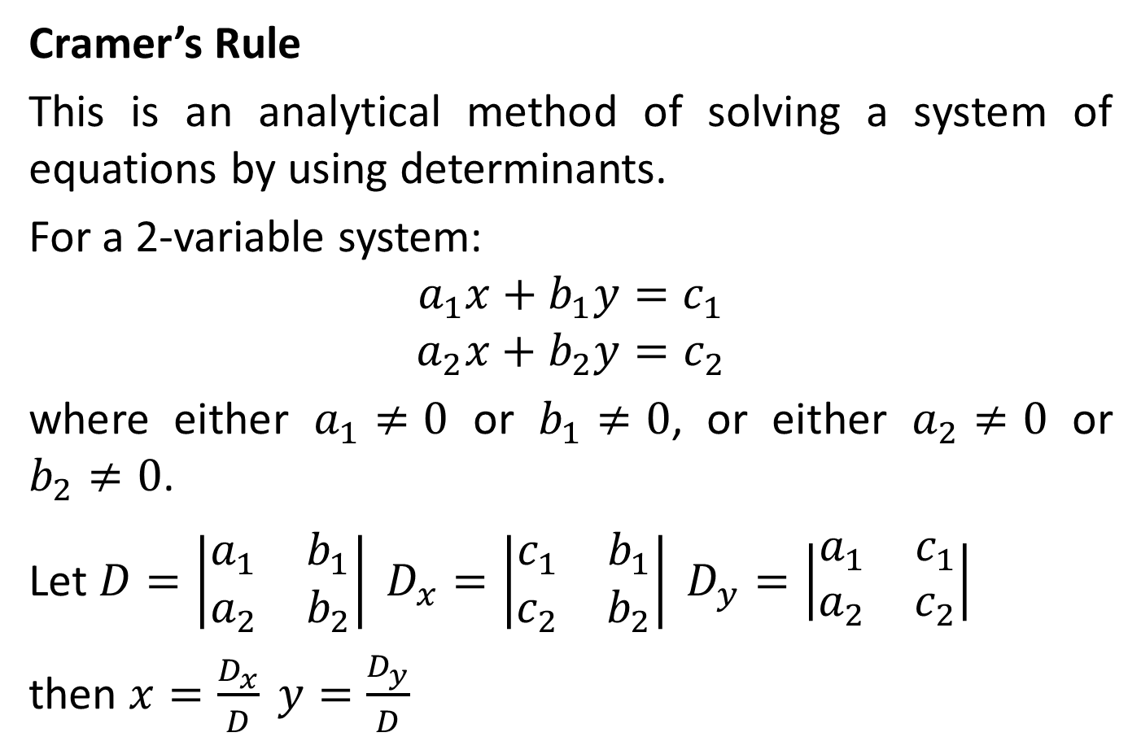
METHODS OF FINDING A SOLUTION
Cramer’s Rule
This is an analytical method of solving a system of equations by using determinants.
For a 2-variable system:
$$a_{1}x+b_{1}y=c_{1}$$
$$a_{2}x+b_{2}y=c_{2}$$
where either $a_{1}≠0$ or $b_{1}≠0$, or either $a_{2}≠0$ or $b_{2}≠0$.
Let $D=\left|\begin{matrix}a_{1} & b_{1} \\ a_{2} & b_{2}\end{matrix}\right| D_{x}=\left|\begin{matrix}c_{1} & b_{1} \\ c_{2} & b_{2}\end{matrix}\right| D_{y}=\left|\begin{matrix}a_{1} & c_{1} \\ a_{2} & c_{2}\end{matrix}\right|$
then $x=\frac{D_{x}}{D} y=\frac{D_{y}}{D}$

Slide 14
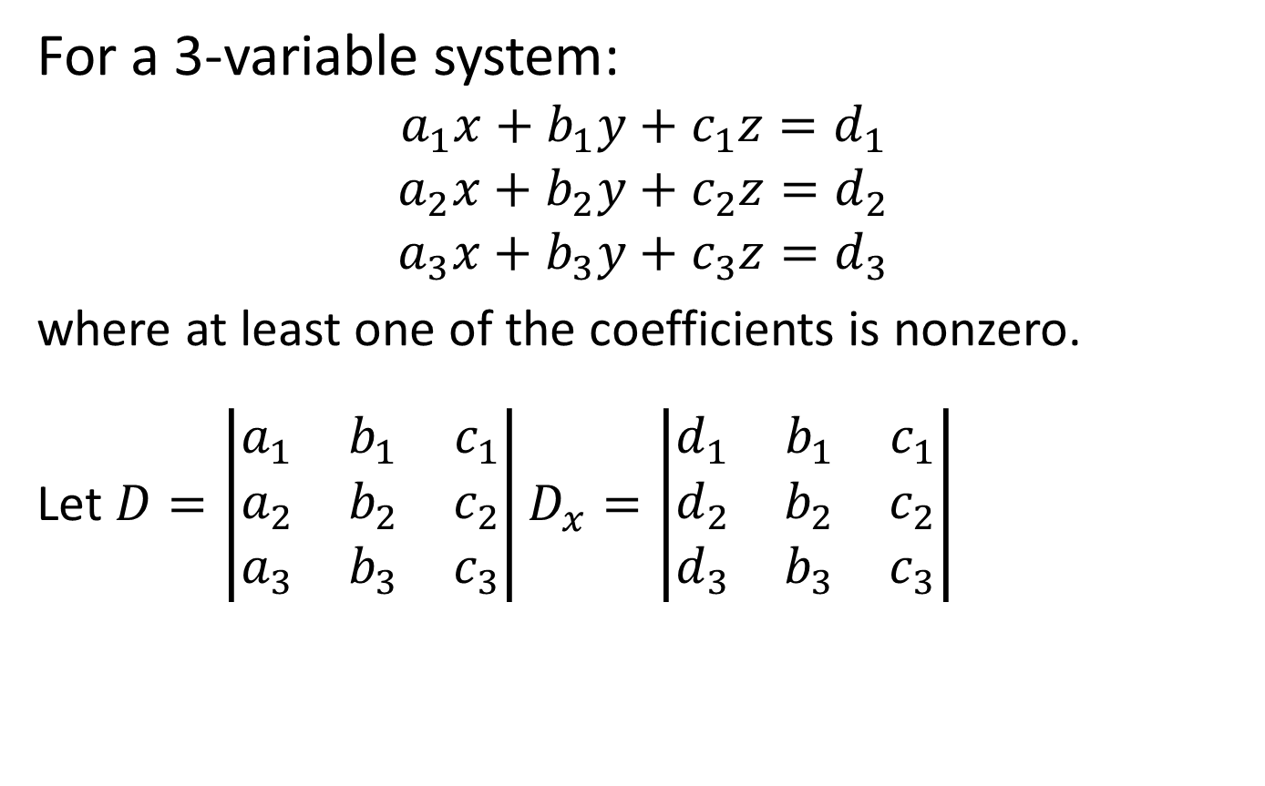
METHODS OF FINDING A SOLUTION
For a 3-variable system:
$$a_{1}x+b_{1}y+c_{1}z=d_{1}$$
$$a_{2}x+b_{2}y+c_{2}z=d_{2}$$
$$a_{3}x+b_{3}y+c_{3}z=d_{3}$$
where at least one of the coefficients is nonzero.
Let $D=\left|\begin{matrix}a_{1} & b_{1} & c_{1} \\ a_{2} & b_{2} & c_{2} \\ a_{3} & b_{3} & c_{3}\end{matrix}\right|D_{x}=\left|\begin{matrix}d_{1} & b_{1} & c_{1} \\ d_{2} & b_{2} & c_{2} \\ d_{3} & b_{3} & c_{3}\end{matrix}\right|$

Slide 15

METHODS OF FINDING A SOLUTION
$$D_{y}=\left|\begin{matrix}a_{1} & d_{1} & c_{1} \\ a_{2} & d_{2} & c_{2} \\ a_{3} & d_{3} & c_{3}\end{matrix}\right|D_{z}=\left|\begin{matrix}a_{1} & b_{1} & d_{1} \\ a_{2} & b_{2} & d_{2} \\ a_{3} & b_{3} & d_{3}\end{matrix}\right|$$
then $x=\frac{D_{x}}{D} y=\frac{D_{y}}{D} z=\frac{D_{z}}{D}$

